Slide 1
MACHINE LEARNING FUNDAMENTALS | ASSIGNMENT 2.3
GROUP 2
How Machine Learning
and Deep Learning Work
Data Processing • Model Training • Neural Network Architecture
GROUP MEMBERS
Gianni Lopez
Ransom Mtombeni
Garima Madas
Venkatesh Muni
Hemant Mahto
Sumit Neupane
AIML 500 Machine Learning Fundamentals
Notes:
SPEAKER 1 · about 0:20 Good morning. We are Group 2. The other groups will show what machine learning and deep learning are and where they are used. Our job is to open the hood and show how they actually work: how the data gets prepared, how a model learns, and what the architecture inside looks like. Timing plan for the whole talk (about 15 minutes, then 4 to 5 minutes of Q&A): - Speaker 1: slides 1 to 5 and slide 17 (about 4.5 min) - Speaker 2: slides 6, 7, 14, 15 (about 3.5 min) - Speaker 3: slides 8, 9, 10, 16 (about 3.5 min) - Speaker 4: slides 11, 12, 13, and moderates Q&A (about 3.5 min) Adjust the split if the group has more or fewer members.

Slide 2
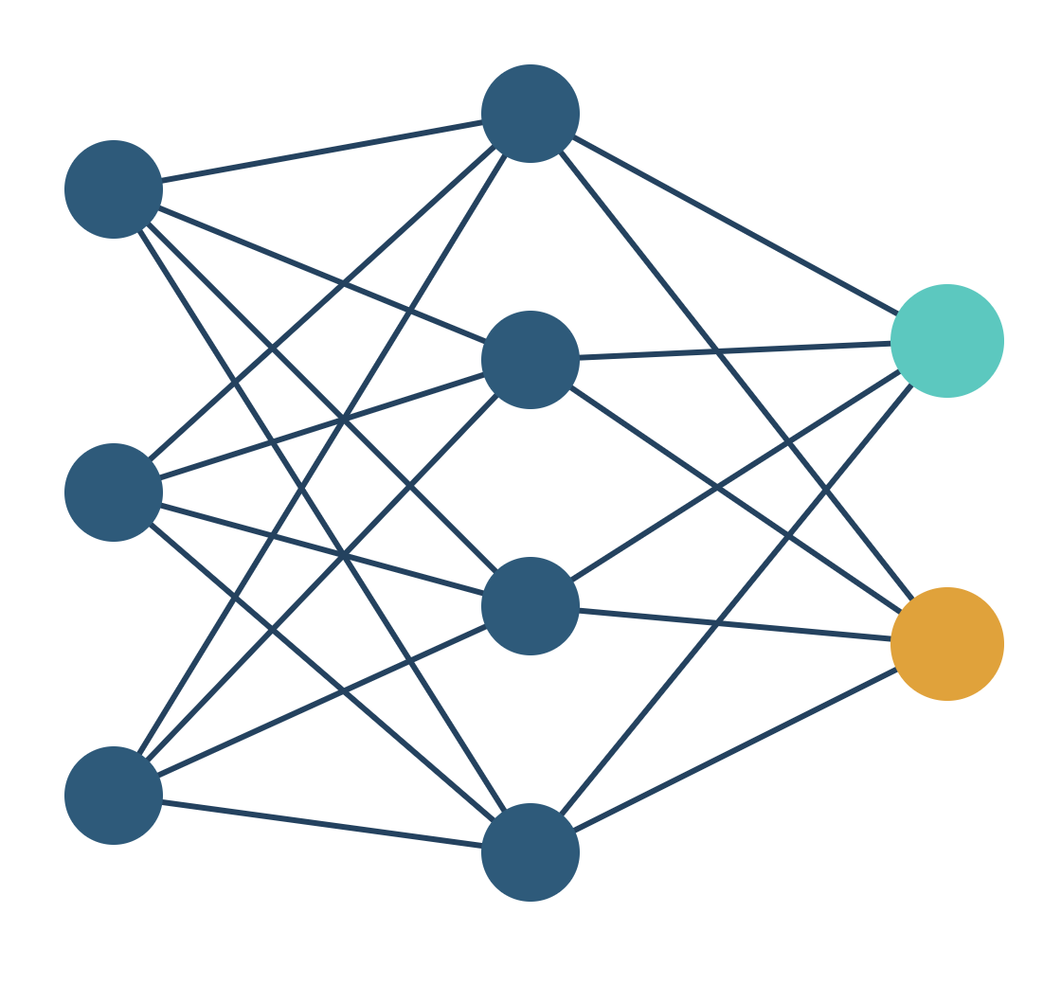
Under the Hood
HOW THEY WORK
How machine learning and deep learning actually work: data processing, model training and architecture
AIML 500 Machine Learning Fundamentals
Notes:
SPEAKER 1 · about 0:20 Good morning. We are Group 2. The other groups will show what machine learning and deep learning are and where they are used. Our job is to open the hood and show how they actually work: how the data gets prepared, how a model learns, and what the architecture inside looks like. Timing plan for the whole talk (about 15 minutes, then 4 to 5 minutes of Q&A): - Speaker 1: slides 1 to 5 and slide 17 (about 4.5 min) - Speaker 2: slides 6, 7, 14, 15 (about 3.5 min) - Speaker 3: slides 8, 9, 10, 16 (about 3.5 min) - Speaker 4: slides 11, 12, 13, and moderates Q&A (about 3.5 min) Adjust the split if the group has more or fewer members.

Slide 3
How did your inbox know an email is spam?
of spam, phishing and malware is blocked before it reaches a Gmail inbox.
99.9%
No engineer wrote a rule for every scam. The system learned to spot them. Today we open the hood and show how.
Source: Kumaran (2019), Google Workspace Blog
2
Notes:
SPEAKER 1 · about 1:00 Quick show of hands: who had a spam email land in their inbox this week? [pause] Now think about the ones you never saw. Google says Gmail blocks more than 99.9 percent of spam, phishing and malware before it reaches the inbox. Nobody sat down and wrote a rule for every scam on the internet. Spammers change their tricks every day. So the system had to learn. That is our question today: how does a machine actually learn? We will keep coming back to one example, the spam filter, so you can see each step in action.

Slide 4
You are the model: spam or not spam?
Email A
Email B
Email C
From: rewards@claim-prize.example
From: program-office@university.example
From: security@account-verify.example
URGENT: You WON a $1,000 gift card. Claim NOW!!!
Updated room and agenda for Saturday’s session
Your account will be suspended. Verify your details here
You just used features: urgency words, ALL CAPS, money, an unknown sender, a link asking for details. Weighing clues like these to reach a decision is what a machine learning model does.
Example emails are made up for this exercise
3
Notes:
SPEAKER 1 · about 1:15 Let us make you the model. Here are three emails. Vote with your hands. Email A: spam or not? [hands] Email B? [hands] Email C? [hands] [Click to reveal the dark box] Notice what you just did. You did not read every word. You looked for clues: urgency, all caps, money, a sender you do not recognize, a link asking for your details. Machine learning calls those clues features. Your brain weighed the features and made a prediction. Email C is the interesting one: it looks calm and professional, but it is phishing. Clues that are harder to spot are exactly where deep learning earns its place, and we will come back to that with Gmail.

Slide 5
Three nested ideas, one key difference
THE BIG PICTURE
Artificial intelligence: machines doing tasks that normally need human judgment
THE KEY DIFFERENCE
Who designs the features?
Machine learning: systems that learn patterns from data instead of following hand-written rules
Deep learning: machine learning that uses neural networks with many layers
ML: people choose what the model looks at.
DL: the network discovers useful features from raw data.
Working definition: a program learns when its performance on a task improves with experience (Mitchell, 1997).
Sources: IBM (2023); Copeland (2016); Mitchell (1997)
4
Notes:
SPEAKER 1 · about 1:15 Before we open the hood, one minute on vocabulary, because these words get mixed up a lot. Artificial intelligence is the broad goal: machines doing things that normally need human judgment. Machine learning is one way to get there. Instead of writing rules by hand, we give the system examples and it learns the patterns. Tom Mitchell’s classic definition: a program learns when its performance on a task improves with experience. Deep learning sits inside machine learning. It uses neural networks with many layers. IBM and NVIDIA both describe these as nested circles, each one inside the other. If you remember one thing from this slide: the big difference is who designs the features. In classic ML, a person decides what the model should look at, like the number of links in an email. In deep learning, the network figures out what to look at from the raw data. That one difference shows up at every stop of our tour.

Slide 6




Three stops under the hood
OUR ROUTE
01
02
03
Data processing
Model training
Architecture
Turning messy, real-world data into clean, labeled numbers a model can learn from
How a model learns: guess, measure the error, adjust, repeat
The structure doing the learning, from decision trees to deep neural networks
Then we put all three together in one real system: Gmail’s spam filter.
Group 2 · How They Work
5
Notes:
SPEAKER 1 · about 0:30 Here is our route. Stop 1: [Speaker 2] covers data processing, how raw data becomes something a model can learn from. Stop 2: [Speaker 3] covers model training, how the learning actually happens. Stop 3: [Speaker 4] covers architecture, what is inside the model, including neural networks. Then we show all three working together inside Gmail’s spam filter. At every stop, we compare how classic ML and deep learning do it differently. Over to [Speaker 2].

Slide 7
Garbage in, garbage out: preparing the data
STOP 1 · DATA PROCESSING
01
02
03
04
05
Collect
Clean
Label
Transform
Split
Gather raw examples
Fix errors, remove duplicates, handle gaps
Attach the right answer to each example
Turn everything into numbers on a similar scale
Keep separate data for training, tuning and testing
In spam
Millions of emails with sender, links and timestamps
In spam
In spam
Drop repeated messages, fix broken text
“Spam” or “not spam”, often from user reports
In spam
In spam
Words become counts or vectors
For example 70% train, 15% validate, 15% test
A model can only be as good as the data it learns from.
Sources: Google (n.d.), Machine Learning Crash Course; Goodfellow et al. (2016)
6
Notes:
SPEAKER 2 · about 1:30 Stop 1 is data processing. Before any learning happens, the data has to be made usable. There is an old rule in computing: garbage in, garbage out. Five steps: 1. Collect: gather raw examples. For a spam filter, that is millions of emails plus details like the sender, the links and the time sent. 2. Clean: real data is messy. We remove duplicates, fix broken text and decide what to do with missing values. 3. Label: for supervised learning, every example needs the right answer attached. Spam or not spam. Every time you click “Report spam”, you are helping create labels. 4. Transform: models only understand numbers. Words become counts or vectors, and values are put on similar scales so one feature does not drown out the others. 5. Split: we hold back data the model never sees during training. Training data to learn, validation data to tune, and test data as the final exam. If the model has seen the exam questions, the score means nothing. This stage applies to both machine learning and deep learning. But they part ways on one step, which is next.

Slide 8
Where ML and DL part ways: who builds the features
STOP 1 · DATA PROCESSING
CLASSIC MACHINE LEARNING
DEEP LEARNING
People engineer the features
The network learns the features
Email | “FREE” count | Links | ALL CAPS | Known sender
A | 2 | 4 | 38% | No
B | 0 | 1 | 2% | Yes
1 Raw input: the email text, or image pixels
2 Tokens: text split into word pieces
3 Embeddings: each token becomes a vector
A person decides which clues matter, and the model learns how much each one counts. Works well on smaller, structured datasets.
4 Layers discover which patterns signal spam
Needs much more data, but far less manual feature design.
Sources: IBM (2023); Goodfellow et al. (2016). Table values are illustrative.
7
Notes:
SPEAKER 2 · about 1:15 Here is where machine learning and deep learning part ways during data processing. Left side, classic machine learning. A person, usually a data scientist, decides which clues matter. Here we turned each email into a row of numbers: how many times “FREE” appears, how many links, how much is in all caps, and whether we know the sender. This is called feature engineering. The model then learns how much weight to give each clue. This works very well when the data is structured and not huge. Right side, deep learning. We skip most of the hand-built features. We feed in the raw email text, or raw pixels for an image. The text is split into tokens, each token becomes a vector of numbers called an embedding, and the layers of the network discover on their own which patterns signal spam. IBM describes this as deep learning automating much of the feature extraction step. The trade-off: deep learning needs much more data, and more computing power. But it can find clues that no human thought to write down. Over to [Speaker 3] for how the learning actually happens.

Slide 9





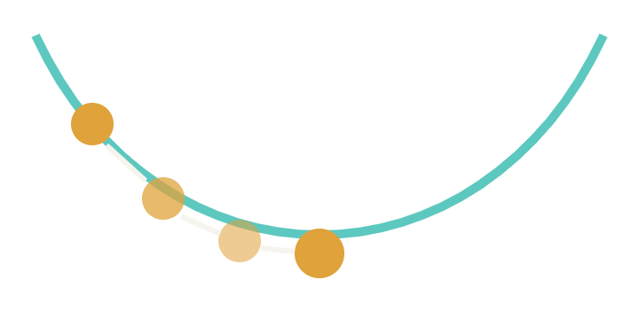
Training is a loop
STOP 2 · MODEL TRAINING
1. Predict
2. Measure loss
3. Adjust
4. Repeat
The model scores an email: 0.80 likely spam
The label says “not spam”. The loss function turns the miss into one error number
Nudge each parameter in the direction that lowers the error
Many passes over the data (epochs) until the error stops falling
Gradient descent: walking downhill in thick fog. You cannot see the bottom, so you feel the slope and step down. The learning rate is your step size.
Sources: Goodfellow et al. (2016); Google (n.d.), Machine Learning Crash Course
8
Notes:
SPEAKER 3 · about 1:15 Stop 2 is training. This is where the “learning” in machine learning happens, and it is a simple loop. 1. Predict. The model looks at an email and makes a guess. Say it says 0.80, so 80 percent likely spam. 2. Measure the loss. We compare the guess with the label. The label says “not spam”, so the model was badly wrong. A loss function turns that miss into a single number: the error. 3. Adjust. The model changes its internal numbers, its parameters, a little bit in the direction that makes the error smaller. 4. Repeat. It does this across the whole training set, many times. Each full pass is called an epoch. We stop when the error stops improving on the validation data. How does it know which direction to adjust? That is gradient descent. Picture walking down a hill in thick fog. You cannot see the bottom, but you can feel which way the ground slopes under your feet, so you take a step downhill, then check again. The learning rate is your step size. Too big and you jump over the valley. Too small and you take forever to get there.

Slide 10
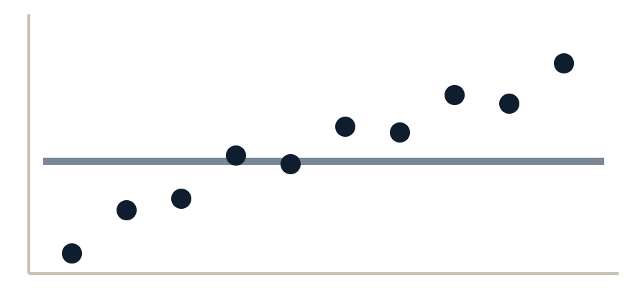
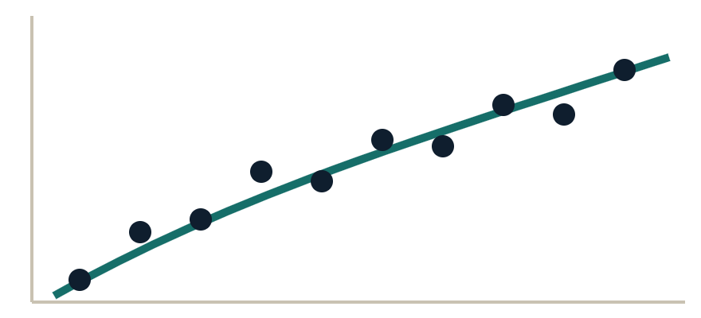
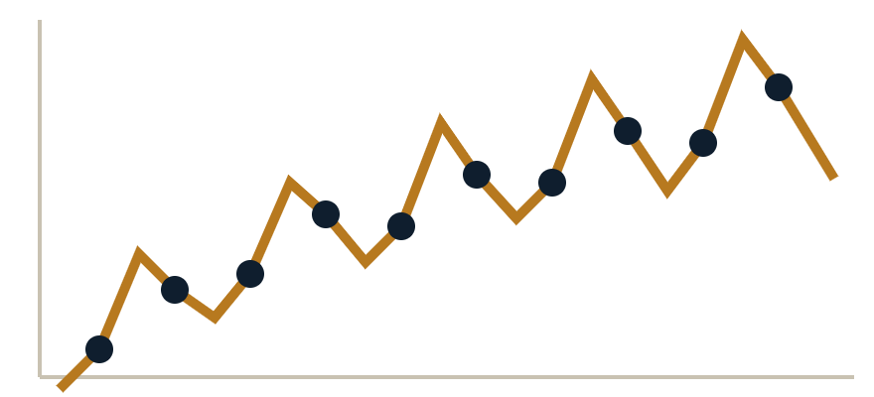
The goal is to generalize, not memorize
STOP 2 · MODEL TRAINING
Underfitting
Good fit (the goal)
Overfitting
Like a student who did not study. Misses even obvious spam.
Understood the concepts. Catches new spam it has never seen.
Memorized the answer key. Perfect on training emails, fooled by a new trick.
How we check: compare scores on training data and validation data. A big gap means overfitting. Fixes: more data, a simpler model, regularization, early stopping, dropout (DL).
Source: Goodfellow et al. (2016). Charts are illustrative.
9
Notes:
SPEAKER 3 · about 1:15 Training has one big trap. The goal is not to do well on the training data. The goal is to do well on data the model has never seen. We call that generalizing. Left: underfitting. The model is too simple, like a student who did not study. A flat line through the data misses the trend. It even misses obvious spam. Middle: a good fit. The model learned the real pattern, like a student who understood the concepts. It catches new spam it has never seen. Right: overfitting. The model memorized the training data, noise and all, like a student who memorized the answer key. It scores perfectly in practice, then fails the real exam when spammers try a new trick. How do we catch it? Remember the split from Stop 1. We compare the score on training data with the score on validation data. If training is great and validation is poor, we are overfitting. Fixes include more data, a simpler model, regularization (a penalty for being too complex), stopping training early, and in deep learning, dropout, which randomly switches off neurons during training so the network cannot rely on memorizing.

Slide 11
Same loop, very different scale
STOP 2 · MODEL TRAINING
 | Classic ML | Deep learning
Weights to learn | Tens to thousands | Millions to billions
Hardware | A normal CPU | GPUs
Training time | Minutes to hours | Hours to weeks
Data needed | Smaller datasets | Large datasets
Turning point: in 2012, a deep network trained on two GPUs won the ImageNet image challenge by a wide margin.
Sources: Brown et al. (2020); Rumelhart et al. (1986); Krizhevsky et al. (2012); LeCun et al. (2015)
10
Notes:
SPEAKER 3 · about 1:00 Classic machine learning and deep learning both use this same loop: predict, measure, adjust, repeat. What changes is the scale. A classic model might learn tens or thousands of numbers. A deep network learns millions to billions. GPT-3, for example, has 175 billion parameters. How the errors get corrected also differs. In deep learning the error has to be shared out across many layers. The method is called backpropagation, published by Rumelhart, Hinton and Williams in 1986: the error flows backward from the output, and each weight gets its share of the blame. Then gradient descent nudges each weight. All that math is mostly matrix multiplication, and GPUs can do thousands of those calculations at once. That is why the turning point came in 2012, when AlexNet, a deep network trained on two GPUs, won the ImageNet image-recognition challenge by a wide margin. That result kicked off the modern deep learning boom. So: more data, more parameters, more computing power. Now [Speaker 4] will show what those parameters actually live inside.

Slide 12
The building block: one artificial neuron
STOP 3 · ARCHITECTURE
INPUTS × WEIGHTS
“FREE” in subject = 1 × +2.1
Σ
Activation
0.97
Number of links = 4 × +0.6
Sigmoid squeezes any number into 0 to 1
sum + bias
97% likely spam
Known sender = 0 × −3.0
Training (Stop 2) is simply finding good weights.
Weights are illustrative. Source: Goodfellow et al. (2016)
11
Notes:
SPEAKER 4 · about 1:15 Stop 3 is architecture: the structure that does the learning. Let us start with the smallest piece of a neural network, one artificial neuron. It takes in inputs. Here, three clues about an email: does the subject say “FREE”, how many links are there, and do we know the sender. Each input is multiplied by a weight. The weight says how much that clue matters, and in which direction. “FREE” pushes toward spam with +2.1. A known sender pushes strongly away from spam with −3.0. The neuron adds everything up, plus a bias, which is like a starting point. Here: 2.1 times 1, plus 0.6 times 4, plus minus 3 times 0, plus a bias of minus 1, equals 3.5. Then an activation function squeezes that number into a range we can use. The sigmoid turns 3.5 into 0.97. So the neuron says: 97 percent likely spam. If the sender had been known, the total would drop to 0.5 and the answer to about 62 percent. Here is the link back to Stop 2: those weights are exactly what training adjusts. They start out random, and the predict, measure, adjust loop slowly finds good values. One neuron on its own is basically a classic ML model called logistic regression. The power comes when we stack many of them.

Slide 13
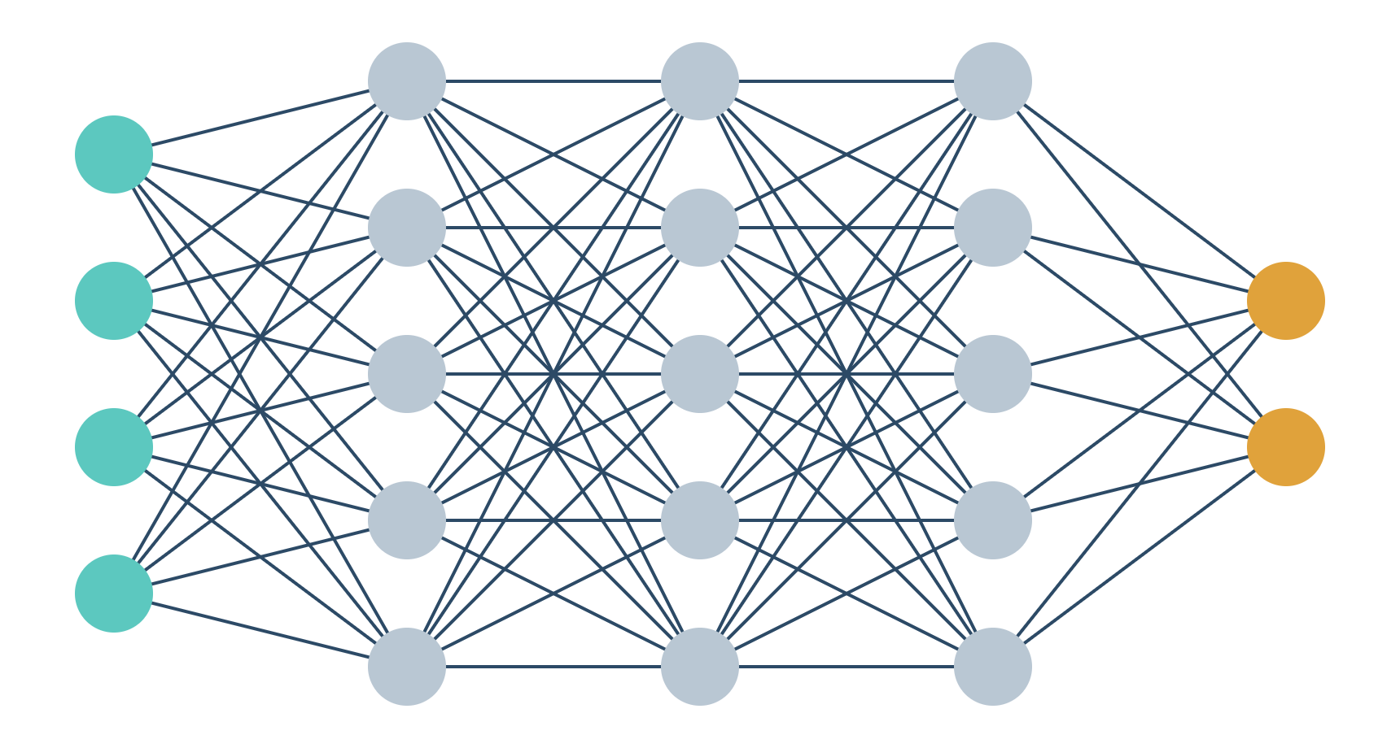
Stack neurons in layers and it goes deep
STOP 3 · ARCHITECTURE
WHAT MAKES IT “DEEP”
More than three layers, counting input and output
Layer 1: edges, characters
Layer 2: shapes, words
Layer 3: object parts, phrases
Output: “cat”, or “spam”
Learning uses backpropagation: the error flows backward and every weight gets its share of the blame.
Input layer
Hidden layers
Output layer
Sources: IBM (2023); LeCun et al. (2015); Rumelhart et al. (1986)
12
Notes:
SPEAKER 4 · about 1:15 Now we stack neurons into layers. On the left is a small network. The input layer takes in the data: pixels, or word vectors. The hidden layers in the middle do the work. Every neuron connects to every neuron in the next layer, and every one of those lines is a weight that training adjusts. The output layer gives the answer: spam or not spam, cat or dog. So what makes it deep? IBM’s rule of thumb: a network with more than three layers, counting the input and output layers, is a deep learning model. Real networks often have dozens or even hundreds of layers. Why does depth matter? Each layer builds on the one before. In an image network, the first layer picks up edges, the next combines edges into shapes, the next combines shapes into parts like eyes or ears, and the output says “cat”. With text it is similar: characters, words, phrases, meaning. LeCun, Bengio and Hinton describe this in their 2015 Nature paper as learning representations at multiple levels of abstraction. This is exactly the automatic feature learning from Stop 1. And training a network this deep uses backpropagation: the error at the output flows backward through the layers, and every weight gets its share of the blame.

Slide 14



Match the architecture to the data
STOP 3 · ARCHITECTURE
TABLES
IMAGES
LANGUAGE
Decision trees
CNN
Transformer
Classic ML. A series of yes or no questions. Often the best choice for rows and columns.
Deep learning. Small filters scan the image for edges, then shapes, then objects.
Deep learning. “Attention” lets each word look at every other word. Powers ChatGPT and Gemini.
Rule of thumb: start simple. Use deep learning when the data is images, audio or text, and there is a lot of it.
Sources: Grinsztajn et al. (2022); Vaswani et al. (2017); LeCun et al. (2015)
13
Notes:
SPEAKER 4 · about 1:00 There is no single best architecture. You pick the one that fits the data. Tables, data in rows and columns like a spreadsheet: classic ML, especially decision trees and their stronger versions like random forests and gradient boosting, are often the best choice. A 2022 study by Grinsztajn and colleagues found tree-based models still beat deep learning on typical tabular data. Images: convolutional neural networks, or CNNs. Small filters slide across the image looking for edges, then shapes, then whole objects. That is the layer-by-layer idea from the last slide. Language: transformers. Introduced in 2017 in the paper “Attention Is All You Need”. Attention lets every word in a sentence look at every other word to work out meaning. Transformers power tools like ChatGPT and Gemini. Rule of thumb: start simple. Reach for deep learning when the data is unstructured, like images, audio or text, and you have a lot of it. Now [Speaker 2] will show all three stops working together in a real product.

Slide 15



Gmail’s spam filter: all three stops at work
REAL-WORLD USE CASE
1. Data processing
2. Model training
3. Architecture
Huge volumes of email. Labels come from users clicking “Report spam” and “Not spam”.
Models are retrained as spammers change tactics. TensorFlow let the team test new models fast.
Layers of defense: rules, classic ML models, and deep learning models added on top.
Scale: 1.5 billion people used Gmail every month (2019).
Source: Kumaran (2019), Google Workspace Blog
14
Notes:
SPEAKER 2 · about 1:00 Let us bring it back to where we started: your inbox. Gmail’s spam filter uses all three stops. 1. Data processing. Gmail sees an enormous volume of email. Every time a user clicks “Report spam” or “Not spam”, that becomes a label. Signals like the sender, the links and the content become features. 2. Model training. Spammers adapt constantly, so the models are retrained and re-tested all the time. In 2019 Google wrote that TensorFlow, its open-source machine learning framework, let the Gmail team experiment with and evaluate new models quickly. The filter is also personalized: what is spam for one person may be a newsletter someone else wants. 3. Architecture. It is not one model. It is layers of defense: rules, classic machine learning models, and newer deep learning models that Google says complement the existing ones. And the scale is huge. In 2019 Gmail had 1.5 billion monthly users. So what did adding deep learning actually change?

Slide 16
WHAT DEEP LEARNING ADDED
100 million
more spam emails blocked every day, on top of the 99.9% already caught
The hard cases older filters missed:
Spam hidden in images
Hidden embedded content
Brand-new domains
Source: Kumaran (2019), Google Workspace Blog
15
Notes:
SPEAKER 2 · about 0:45 In 2019 Google reported that after adding TensorFlow deep learning models, Gmail was blocking about 100 million more spam messages every day, on top of the 99.9 percent it was already catching. Where did those extra messages come from? The hard cases: spam hidden inside images, emails with hidden embedded content, and messages from brand-new domains that slip a little spam into normal traffic. Why did deep learning help here? This is our group’s interpretation: these messages hide the obvious hand-made clues, like the word “FREE” or a known bad link. A deep network does not need someone to write those clues down. It learns its own signals straight from the raw content. That is the feature difference from Stop 1, paying off in the real world. For context, news coverage did the math: spread across 1.5 billion users, that is about one extra blocked email per ten users per day (Thubron, 2019). When you are already at 99.9 percent, the last 0.1 percent is the hardest to catch.

Slide 17
ML vs DL at each stop
SIDE BY SIDE
 | Classic ML | Deep learning
Data processing | People build the features | Learns features from raw data
Model training | Small, fast, CPU | Huge, slow, GPUs
Architecture | Trees, linear models | Neural networks: CNNs, transformers
Best for | Tables, smaller data | Images, audio, text, big data
Explainability | Easier to explain | Harder, a “black box”
Sources: IBM (2023); Goodfellow et al. (2016)
16
Notes:
SPEAKER 3 · about 0:45 Here is the whole tour on one slide. Data processing: in classic ML, people build the features. In deep learning, the network learns them from raw data. Training: classic ML is small and fast and runs on a normal computer. Deep learning is huge, slower and needs GPUs. Architecture: classic ML uses things like decision trees and linear models. Deep learning uses neural networks, like CNNs and transformers. Best for: classic ML for tables and smaller datasets. Deep learning for images, audio, text and very large datasets. Explainability: a decision tree is easy to explain. A deep network with billions of weights is much harder, which is why people call it a black box. Group 6 will go deeper on that. Neither one is “better”. The right choice depends on the data and the problem.

Slide 18
Three things to remember
WHY IT MATTERS
1
Data sets the ceiling. A model is only as good as the data it learns from.
2
Training is a loop. Guess, measure, adjust. Deep learning runs the same loop at a far bigger scale.
3
Architecture should fit the data. Trees for tables, CNNs for images, transformers for language.
Next time a scam skips your inbox, you will know what happened under the hood.
Group 2 · How They Work
17
Notes:
SPEAKER 1 · about 1:00 So why does this matter? One: data sets the ceiling. No model, however clever, can be better than the data it learns from. That is why so much effort goes into Stop 1. Two: training is a loop. Guess, measure, adjust. Deep learning runs the same loop, just with far more data, far more weights and far more computing power. Three: architecture should fit the data. Trees for tables, CNNs for images, transformers for language. Where is the field heading? Bigger foundation models built on transformers, a push for smaller and more efficient models that can run on a phone, and growing pressure to explain how models reach their decisions. So next time a scam skips your inbox, you will know what happened under the hood: data, training and architecture working together. Thank you. We would love your questions.

Slide 19
Questions?
OUR QUESTION FOR YOU FIRST
For the data you work with every day, would you start with classic ML or deep learning? Why?
Notes:
SPEAKER 4 moderates · 4 to 5 minutes Open by asking the class the question on screen, take one or two answers, then invite questions. Pass each question to the speaker who owned that stop. Likely questions and short answers: Is a neural network with one hidden layer “deep learning”? Not by IBM’s rule of thumb. Deep means more than three layers, counting input and output. When would you NOT use deep learning? Small or tabular datasets, when you must explain each decision, or when compute is limited. Tree-based models often win on tables (Grinsztajn et al., 2022). What is backpropagation in plain words? The error at the output is passed backward through the network, so each weight learns how much it contributed to the mistake. Gradient descent then adjusts it. How do you know a model is overfitting? Training score is high but validation score is much lower. Fix with more data, a simpler model, regularization, early stopping or dropout. Why GPUs? Training is mostly matrix multiplication. GPUs do thousands of these calculations in parallel. Does deep learning still need data processing? Yes. Less manual feature engineering, but still collecting, cleaning, labeling, tokenizing and splitting. Is Gmail’s filter supervised learning? Mostly. It learns from labeled examples, including user reports, combined with rules. Google also describes it as personalized. If you do not know an answer, say so and offer to follow up. That still scores well on engagement.

Slide 20
References (1 of 2)
Brown, T. B., Mann, B., Ryder, N., Subbiah, M., Kaplan, J., Dhariwal, P., . . . Amodei, D. (2020). Language models are few-shot learners. Advances in Neural Information Processing Systems, 33, 1877–1901.
Copeland, M. (2016, July 29). What’s the difference between artificial intelligence, machine learning and deep learning? NVIDIA Blog. https://blogs.nvidia.com/blog/whats-difference-artificial-intelligence-machine-learning-deep-learning-ai/
Goodfellow, I., Bengio, Y., & Courville, A. (2016). Deep learning. MIT Press.
Google. (n.d.). Machine learning crash course. Google for Developers. https://developers.google.com/machine-learning/crash-course
Grinsztajn, L., Oyallon, E., & Varoquaux, G. (2022). Why do tree-based models still outperform deep learning on typical tabular data? Advances in Neural Information Processing Systems, 35.
IBM. (2023, July 6). AI vs. machine learning vs. deep learning vs. neural networks: What’s the difference? IBM Think. https://www.ibm.com/think/topics/ai-vs-machine-learning-vs-deep-learning-vs-neural-networks
Krizhevsky, A., Sutskever, I., & Hinton, G. E. (2012). ImageNet classification with deep convolutional neural networks. Advances in Neural Information Processing Systems, 25.
APA 7th edition
18
Notes:
Reference slides are for the instructor and for anyone reviewing the deck afterward. No need to present them; leave them up briefly at the end.

Slide 21
References (2 of 2)
Kumaran, N. (2019, February 6). Spam does not bring us joy: Ridding Gmail of 100 million more spam messages with TensorFlow. Google Workspace Blog. https://workspace.google.com/blog/product-announcements/ridding-gmail-of-100-million-more-spam-messages-with-tensorflow
LeCun, Y., Bengio, Y., & Hinton, G. (2015). Deep learning. Nature, 521(7553), 436–444. https://doi.org/10.1038/nature14539
Mitchell, T. M. (1997). Machine learning. McGraw-Hill.
Rumelhart, D. E., Hinton, G. E., & Williams, R. J. (1986). Learning representations by back-propagating errors. Nature, 323(6088), 533–536. https://doi.org/10.1038/323533a0
Thubron, R. (2019). Gmail is blocking an extra 100 million spam emails per day using TensorFlow. TechSpot. https://www.techspot.com/news/78632-gmail-blocking-extra-100-million-spam-emails-day.html
Vaswani, A., Shazeer, N., Parmar, N., Uszkoreit, J., Jones, L., Gomez, A. N., Kaiser, Ł., & Polosukhin, I. (2017). Attention is all you need. Advances in Neural Information Processing Systems, 30.
APA 7th edition
19
Notes:
Reference slides are for the instructor and for anyone reviewing the deck afterward.

